Slide 1
The Surprising Science of Using Your Imagination 210,415 Views Expertco-Authored Updated 2 Weeks Ago
A presentation by Wilhelmina Oldenburg, reseacher in Executive Imagination Science
Notes:
Seed: imagination Generator: Title slide Context: {'topic': 'imagination', 'presenter': 'Wilhelmina Oldenburg', 'seed': 'imagination', 'seed_wikihow_action_ing_title': 'Using Your Imagination\n\n\n\n\n\n\t\t\t\t\t\t210,415 Views\t\t\t\t\t\n\n\n\t\t\t\t\t\t\tExpertco-Authored\t\t\t\t\t\t\n\n\n\t\t\t\t\t\tUpdated 2 Weeks Ago', 'seed_title': 'Imagination'} Generated Elements: ['The Surprising Science of Using Your Imagination\n\n\n\n\n\n\t\t\t\t\t\t210,415 Views\t\t\t\t\t\n\n\n\t\t\t\t\t\t\tExpertco-Authored\t\t\t\t\t\t\n\n\n\t\t\t\t\t\tUpdated 2 Weeks Ago', 'A presentation by Wilhelmina Oldenburg, reseacher in Executive Imagination Science']

Slide 2
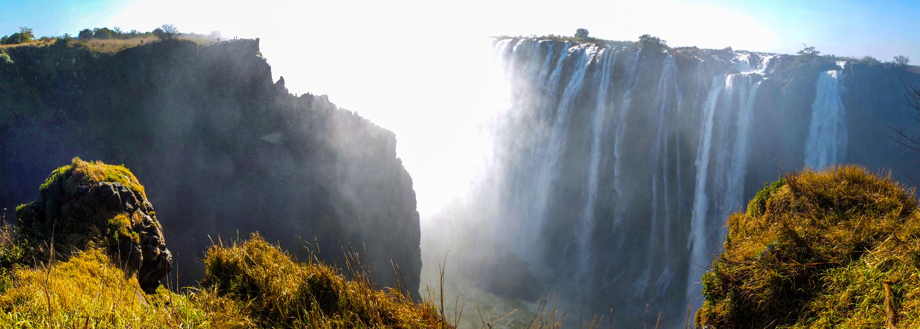
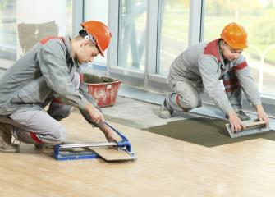

Personal background
Zambia
Tile Setter
Passion
Notes:
Seed: unimaginable Generator: About Me: Location-Job-WeirdHobby Context: {'topic': 'imagination', 'presenter': 'Wilhelmina Oldenburg', 'seed': 'unimaginable'} Generated Elements: ('Personal background', 'Zambia', '/downloads/google_images/Zambia/7818341606_31cd987b00_o_zambia-1.jpg', 'Tile Setter', '/downloads/google_images/Tile Setter/2892.jpg', 'Passion', '/app/talkgenerator/schema/../../downloads/shitpostbot/doomguy-reap-face-57c68ecf232e3.png', True)

Slide 3
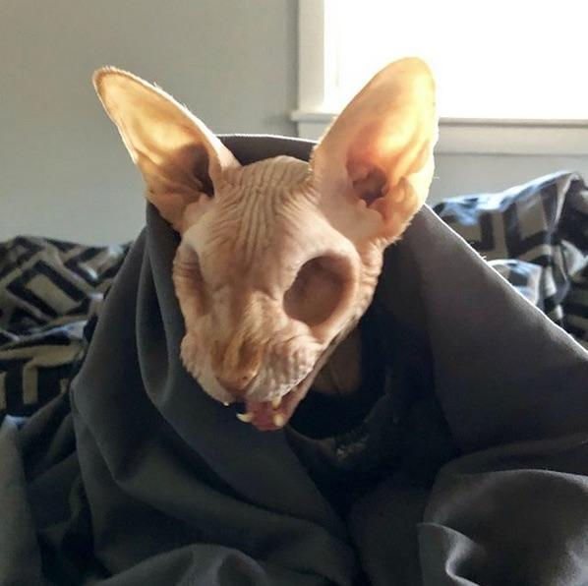

Let's Discuss Beyond Beliefs
Past
Present
Notes:
Seed: beyond belief Generator: Two Captions Weird Context: {'topic': 'imagination', 'presenter': 'Wilhelmina Oldenburg', 'seed': 'beyond belief', 'seed_is_noun_plural_title': 'Beyond Beliefs'} Generated Elements: ("Let's Discuss Beyond Beliefs", 'Past', '/app/talkgenerator/schema/../../downloads/reddit/hmmm+hmm+wtf+wtfstockphotos+photoshopbattles+confusing_perspective+cursedimages+HybridAnimals+EyeBleach+natureismetal/zxyaqq83lrr21.jpg', 'Present', '/app/talkgenerator/schema/../../downloads/shitpostbot/circle-57b1cd35499b3.jpeg', True)

Slide 4
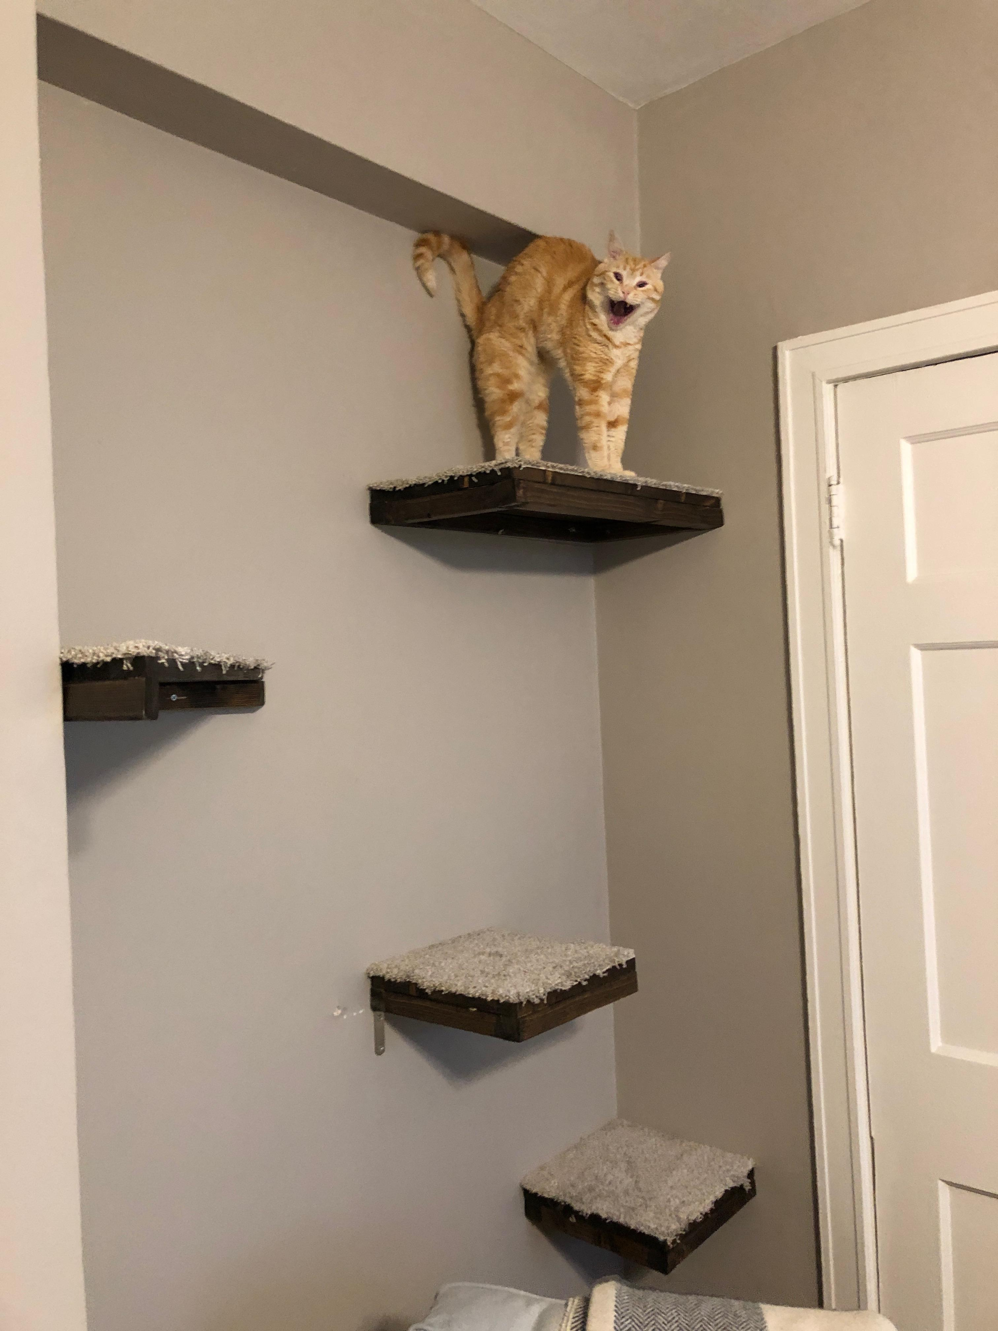
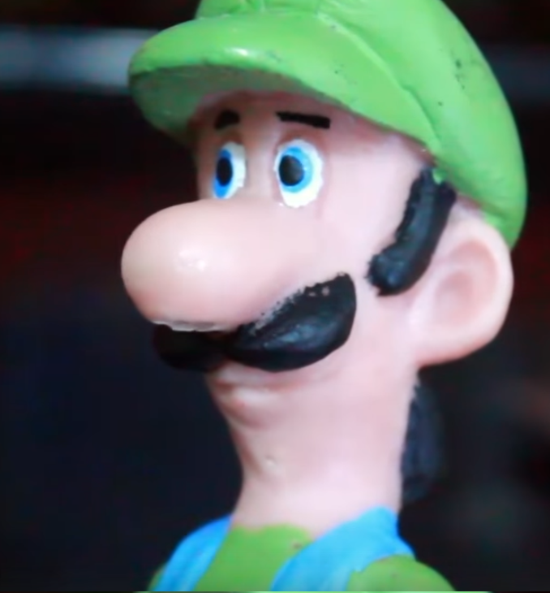
Discussion
Good
Bad
Notes:
Seed: beyond_belief Generator: Two Captions Weird Context: {'topic': 'imagination', 'presenter': 'Wilhelmina Oldenburg', 'seed': 'beyond_belief'} Generated Elements: ('Discussion', 'Good', '/app/talkgenerator/schema/../../downloads/reddit/hmmm+hmm+wtf+wtfstockphotos+photoshopbattles+confusing_perspective+cursedimages+HybridAnimals+EyeBleach+natureismetal/VViBdhS.jpg', 'Bad', '/app/talkgenerator/schema/../../downloads/shitpostbot/luigi-tries-meth-588b7c8597df1.png', True)

Slide 5
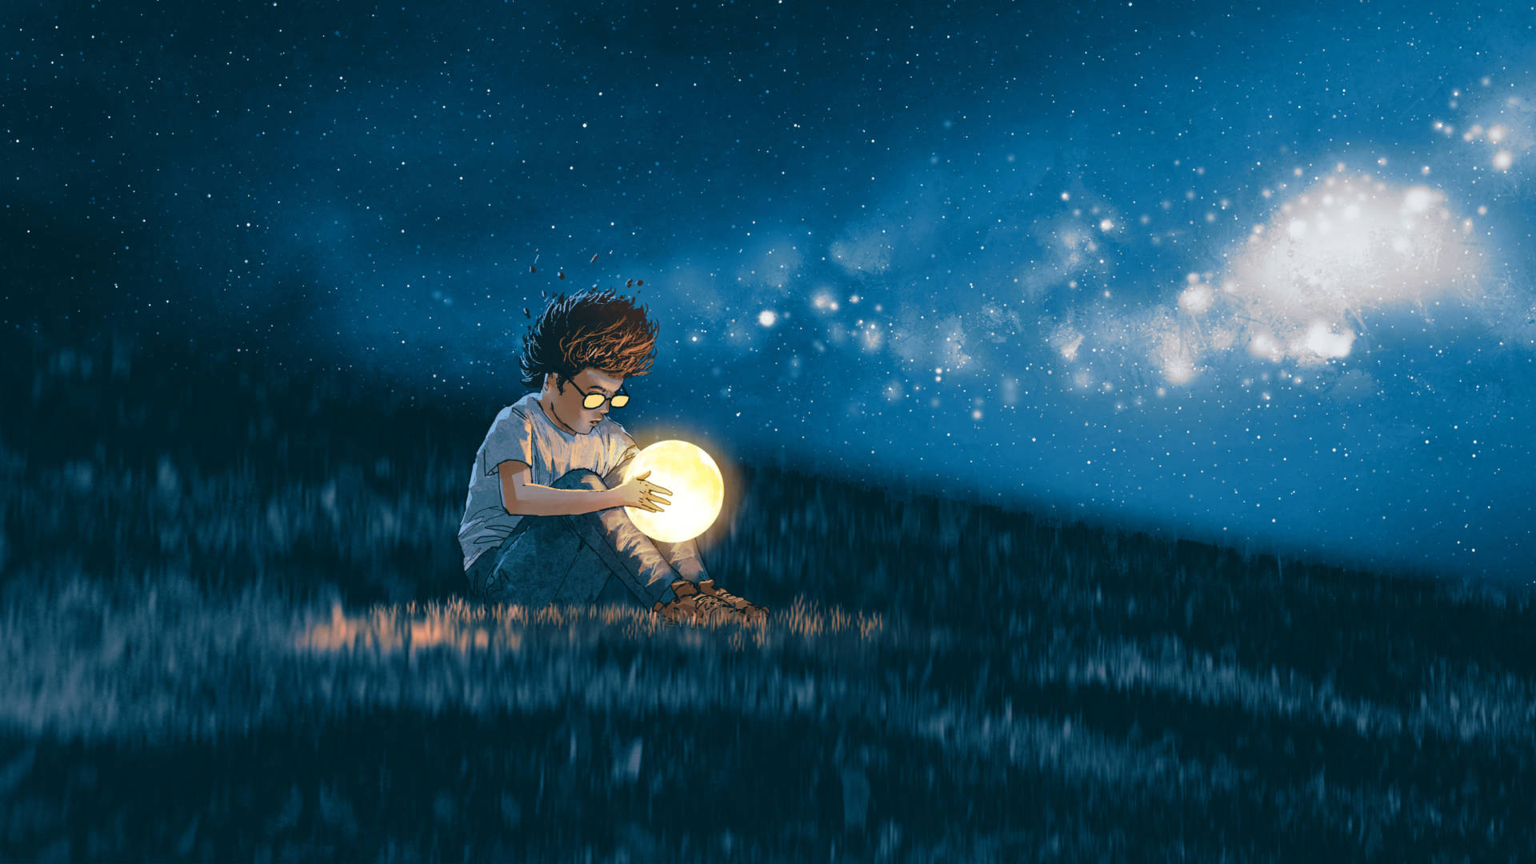
Imaginations
Notes:
Seed: imagination Generator: Wide Google Images Context: {'topic': 'imagination', 'presenter': 'Wilhelmina Oldenburg', 'seed': 'imagination', 'seed_singular_a_title': 'An Imagination', 'chart_title': "An Imagination's Favourite Location", 'seed_plural_title': 'Imaginations'} Generated Elements: ['Imaginations', '/downloads/google_images/imagination/istock-911463836-1920x1080.jpg', True]

Slide 6
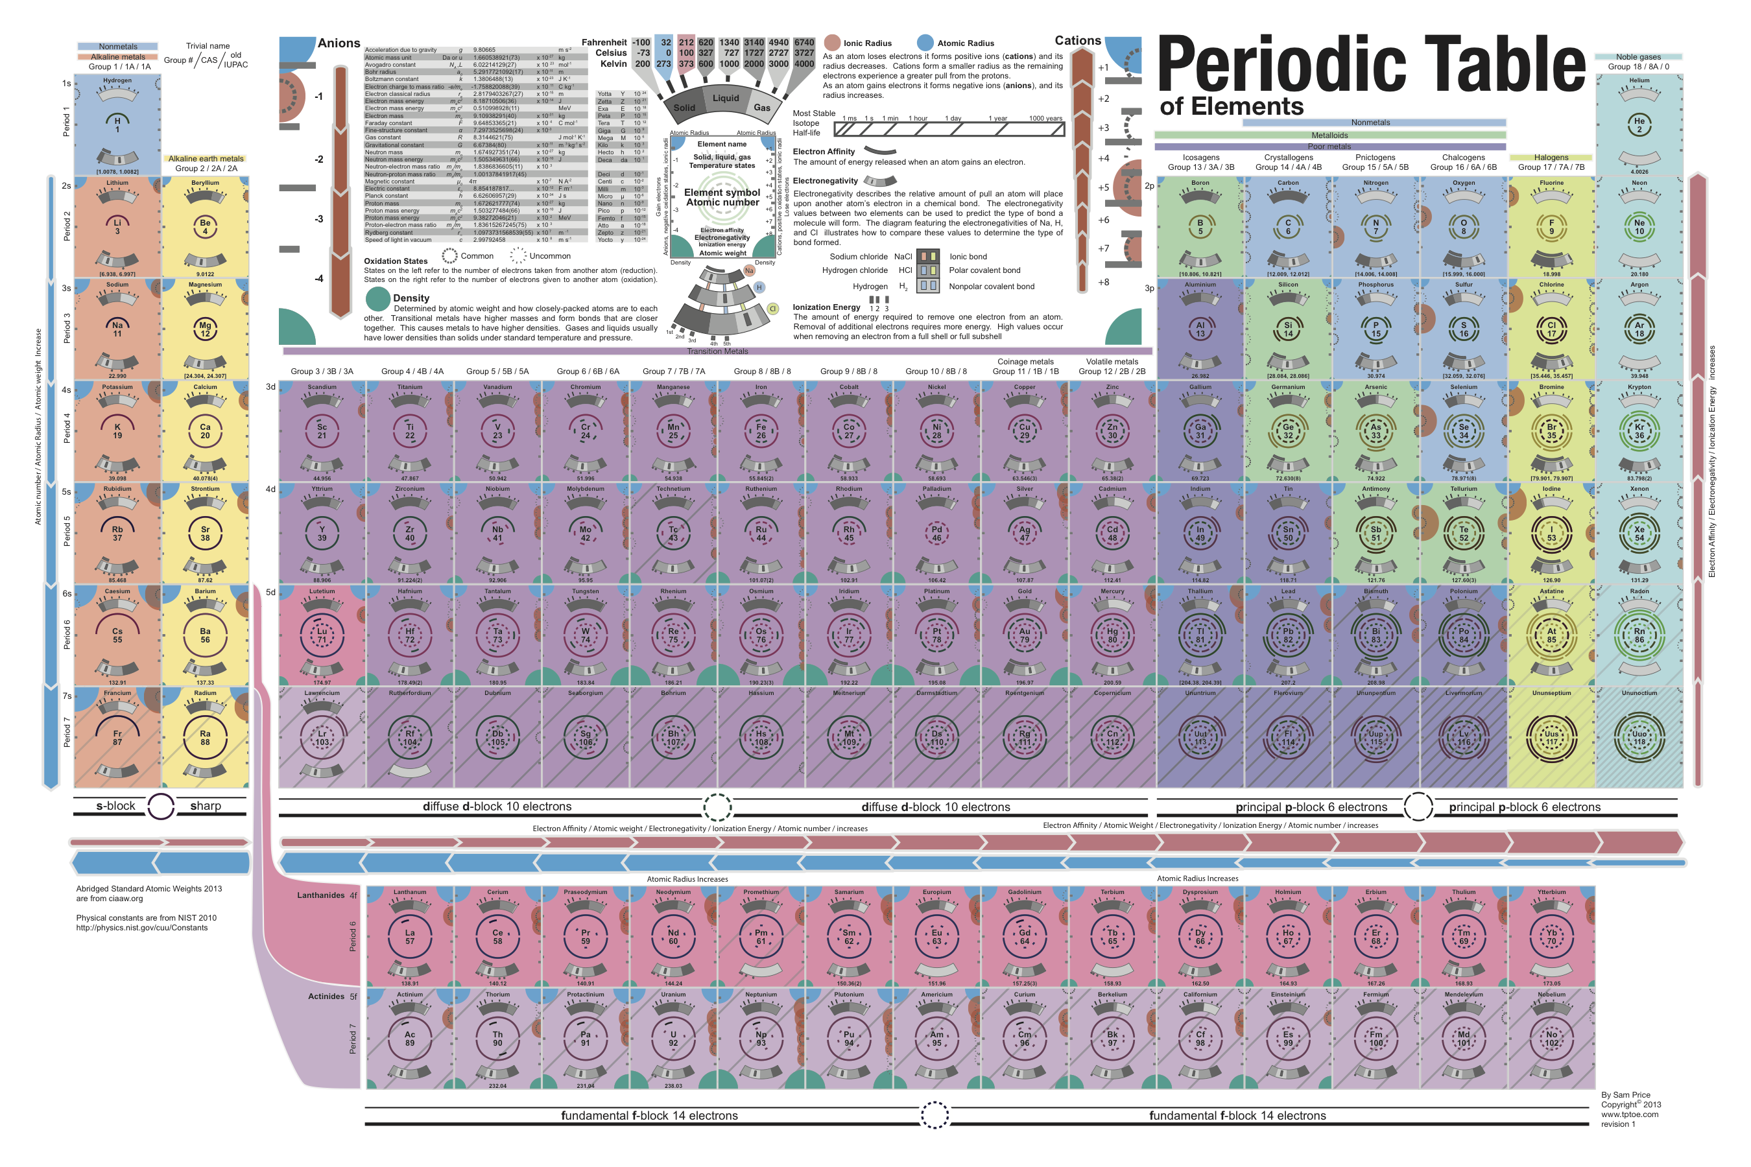
Notes:
Seed: image Generator: Reddit Chart Context: {'topic': 'imagination', 'presenter': 'Wilhelmina Oldenburg', 'seed': 'image'} Generated Elements: [None, '/app/talkgenerator/schema/../../downloads/reddit/dataisbeautiful+funnycharts+charts/2i9i7itxsohy.png', True]

Slide 7
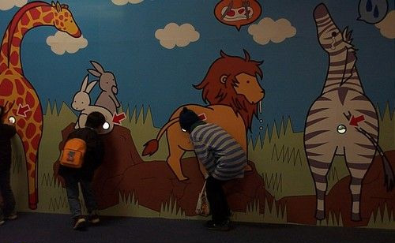

About Tropes
Me
Them
Notes:
Seed: trope Generator: Two Captions Weird Reddit Context: {'topic': 'imagination', 'presenter': 'Wilhelmina Oldenburg', 'seed': 'trope', 'seed_is_noun_plural_title': 'Tropes'} Generated Elements: ('About Tropes', 'Me', '/app/talkgenerator/schema/../../downloads/reddit/hmmm+hmm+wtf+wtfstockphotos+photoshopbattles+confusing_perspective+cursedimages+HybridAnimals+EyeBleach+natureismetal/lW3rQ.jpg', 'Them', '/app/talkgenerator/schema/../../downloads/shitpostbot/cool-sonic-5845c04567b35.jpeg', True)

Slide 8
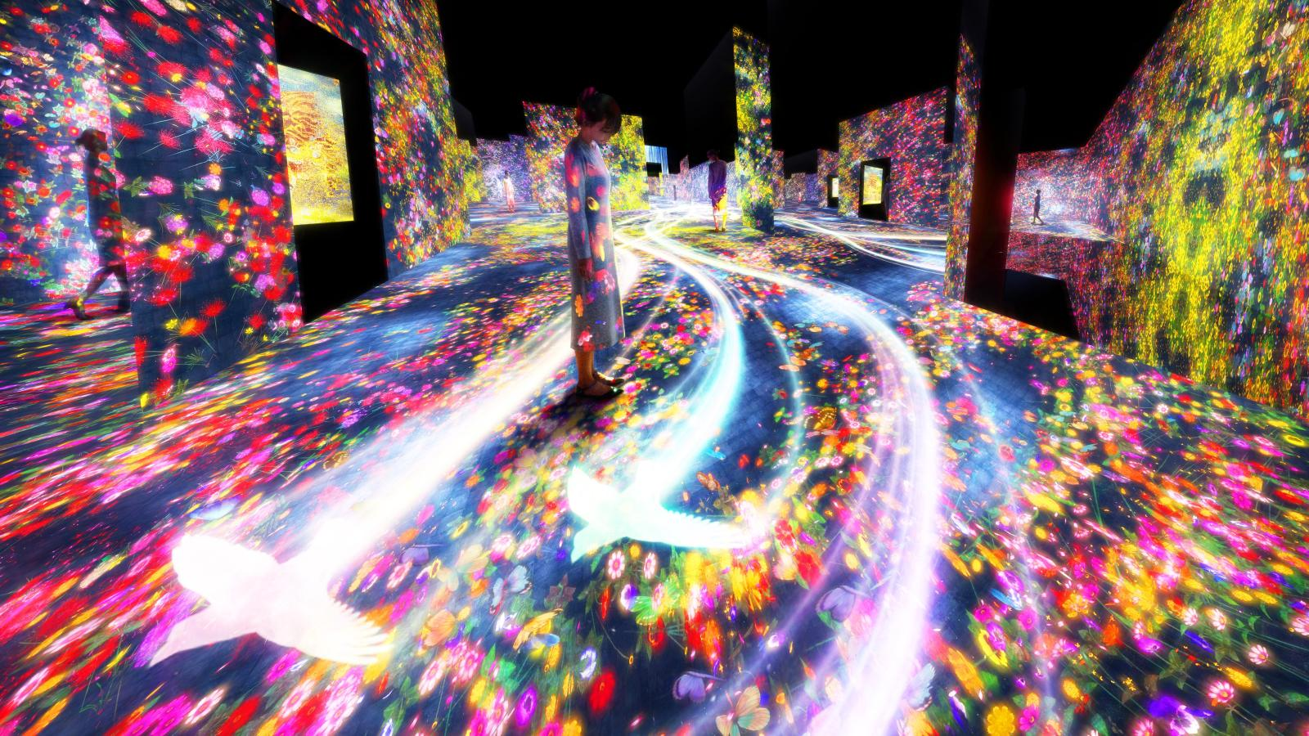
"It is good to love many things, for therein lies the true strength, and whosoever loves much performs much, and can accomplish much, and what is done in love is well done."
Notes:
Seed: art Generator: Goodreads Quote Context: {'topic': 'imagination', 'presenter': 'Wilhelmina Oldenburg', 'seed': 'art'} Generated Elements: [None, '"It is good to love many things, for therein lies the true strength, and whosoever loves much performs much, and can accomplish much, and what is done in love is well done."', '/downloads/google_images/art/teamlab-borderless_main-e1517976693971.jpg']

Slide 9
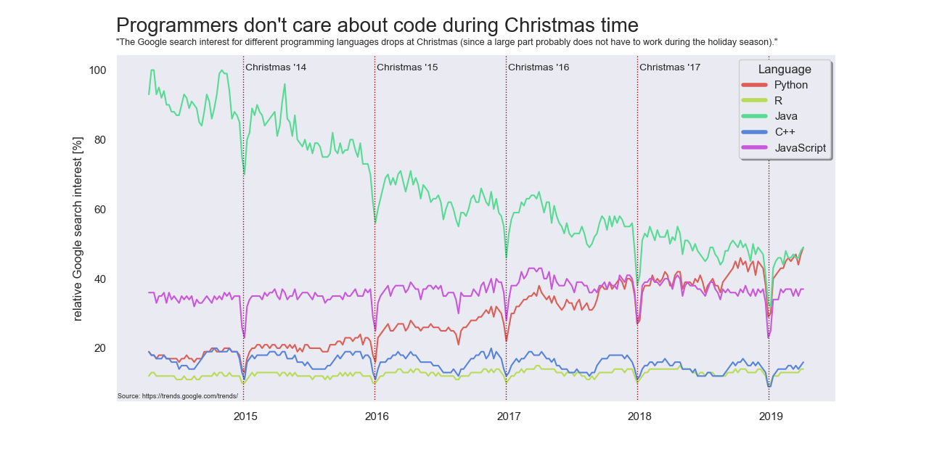
Notes:
Seed: imagination Generator: Reddit Chart Context: {'topic': 'imagination', 'presenter': 'Wilhelmina Oldenburg', 'seed': 'imagination'} Generated Elements: [None, '/app/talkgenerator/schema/../../downloads/reddit/dataisbeautiful+funnycharts+charts/fyhr51ru7vq21.png', True]

Slide 10
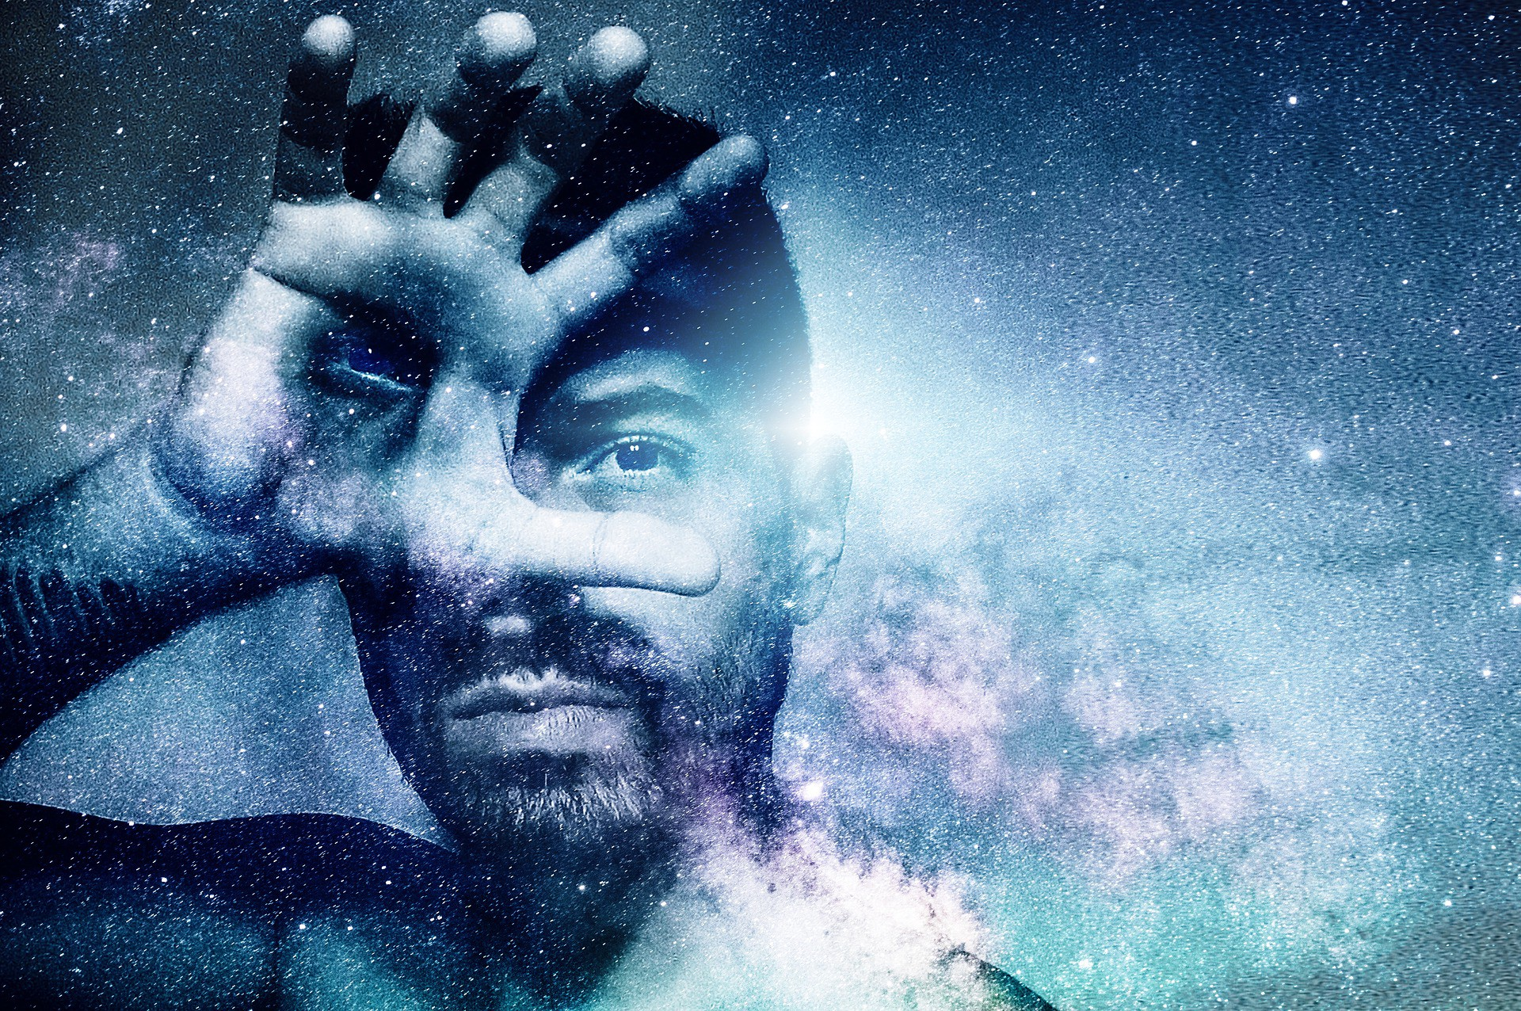
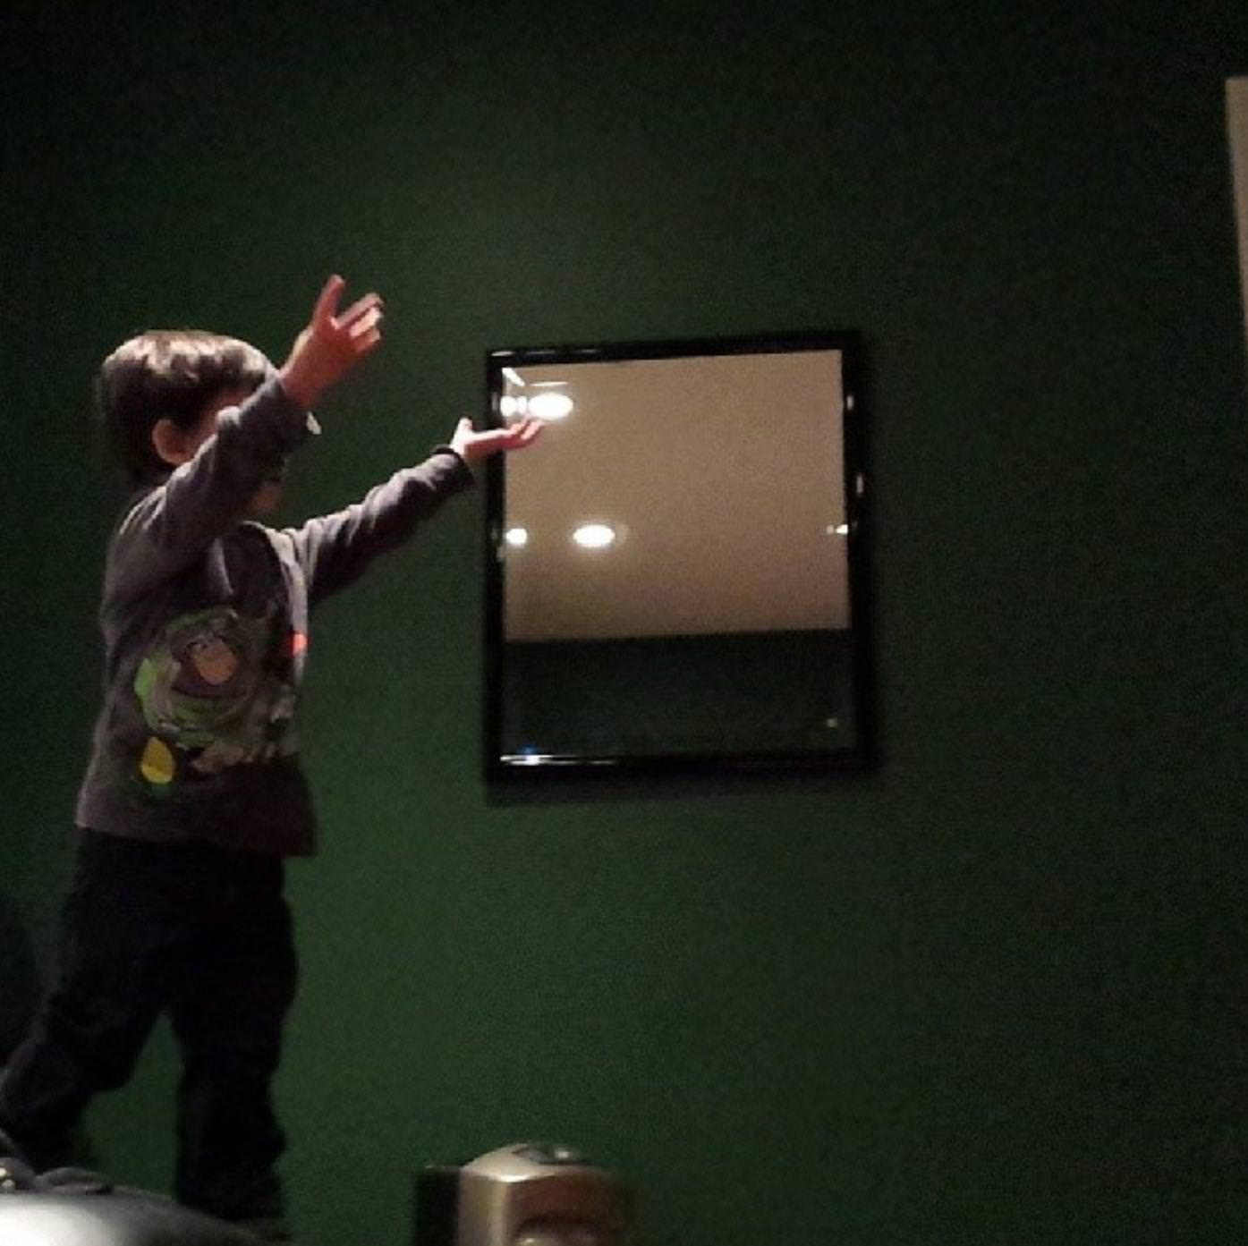
Key Points to End
Conclusion 1
Conclusion 2
Conclusion 3
Notes:
Seed: imagination Generator: Conclusion Context: {'topic': 'imagination', 'presenter': 'Wilhelmina Oldenburg', 'seed': 'imagination'} Generated Elements: ['Key Points to End', 'Conclusion 1', '/downloads/google_images/imagination/1*1eeiwxfngoj4sou5g4q4ua.jpeg', 'Conclusion 2', '/app/talkgenerator/schema/../../downloads/reddit/hmmm+hmm+wtf+wtfstockphotos+photoshopbattles+confusing_perspective+cursedimages+HybridAnimals+EyeBleach+natureismetal/Ygy1adj.jpg', 'Conclusion 3', '/app/talkgenerator/schema/../../downloads/reddit/gifs+gif+gifextra+nonononoYES/w5eyg5q.gif', True]

